Slide 1
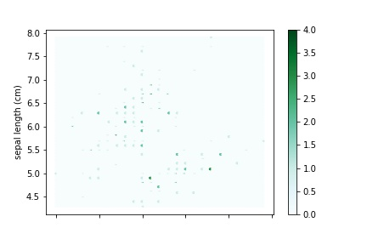
The main purpose is to represent the relative density of data points, this is to prevent the plot from becoming cluttered with high volumes of data.
The most important part is the color and transparency of data points to correctly convey the meaning of the data points.

